Slide 1
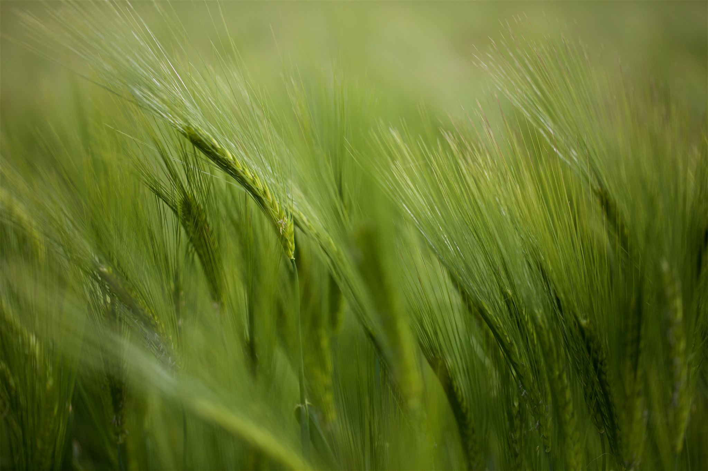
Regenerative Farming
Strategies for dirt to soil and carbon capture
Notes:
Good Morning Ladies and Gentlemen. Welcome to Killochries Fold and Lukeston Farm and thank you for being with us today. We have some interesting speakers for you, all of whom have told to be brief, so please bear with
us.
My name is Iain Graham and I am responsible for the Aird Farming Group.

Slide 2
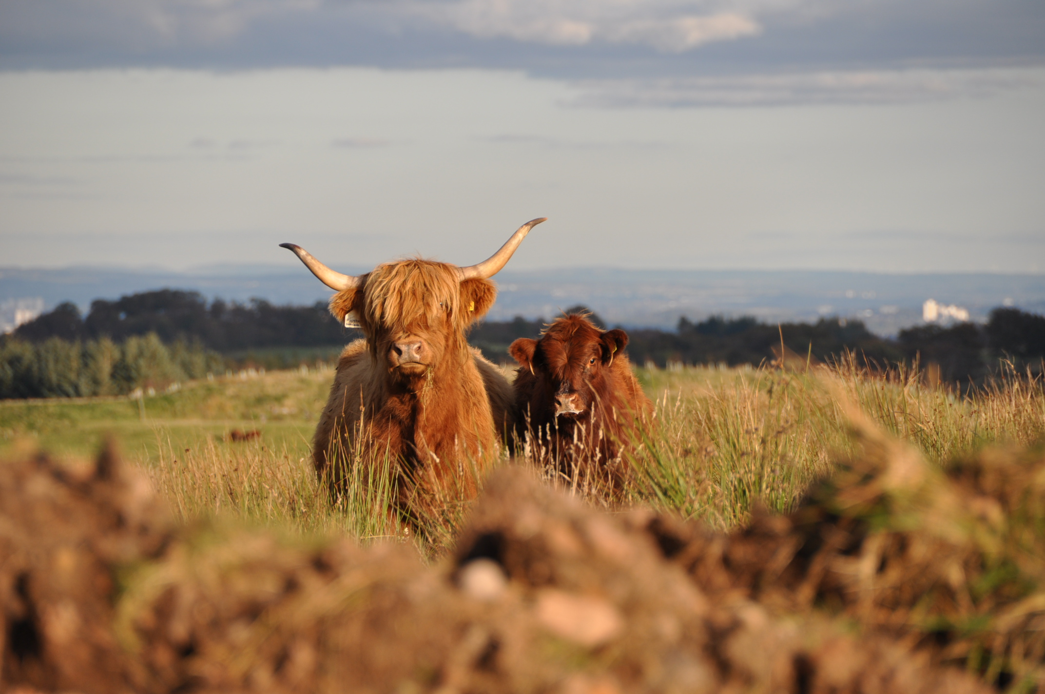
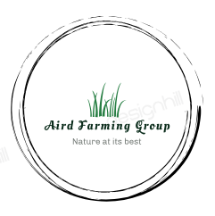
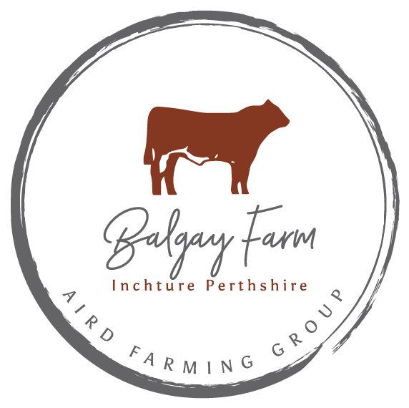
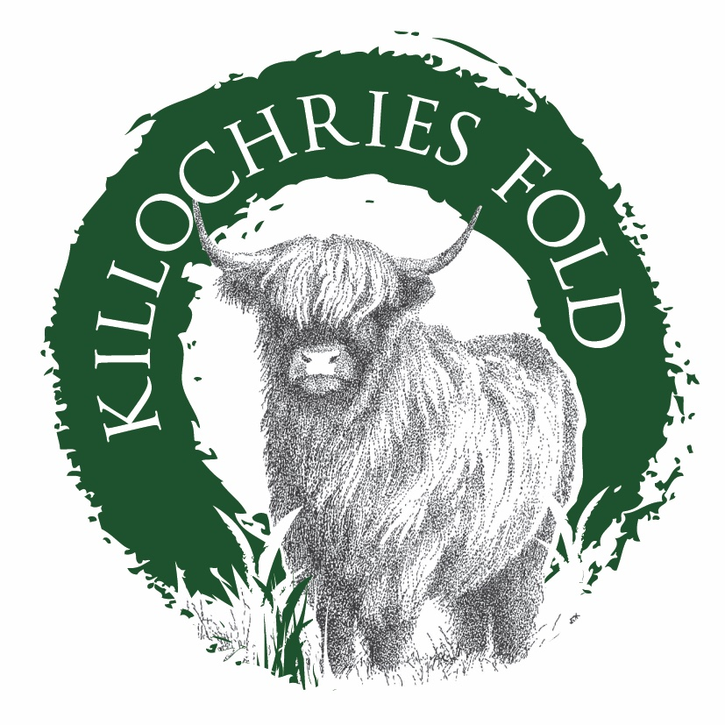
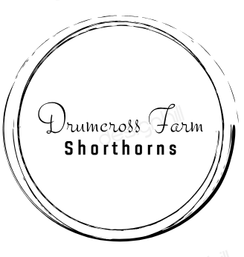
Aird Farming Group
Strategies for regenerative agriculture
Inchture, Perthshire
Stock (Shorthorn, Aberdeen Angus & sheep)
Arable (wheat, barley, rape)
1000 acres heavy soil, flat ground. 700 acres crop, remainder grass.
Regenerative farming practice (direct drill, cover crops, hedges, organic matter ‘dirt to soil’)
Lukestone farm, Renfrewshire
Stock (Highlanders, Shorthorn & sheep)
Trees
Renewables (windmill)
Badachro, Wester Ross
Stock (Highlanders)
Trees (180,000 planted native species)
Renewables (hydro electric)
Notes:
The Aird Farming Group consists of : - Balgay Farm, in the Carse of Gowrie, between Perth and Dundee. Balgay extends to 1000 acres and is run by Iain Wilkinson who is currently in the final of four for the British Arable Farmer of the year. Iain, well done.
Drumcross Farm in Bishopton extends to180 acres. Drumcross is run by Susan and Allan Gordon.
Killochries Fold incorporating Killochries and Lukeston Hill, extends to 400 acres is run by Davy Paterson.
Shieldaig Croft in Gairloch, Wester Ross. Extends to 1000 acres of which 800 acres are in a new native plantation of 180,000 trees. Our daughter Mairi is active in the running of Shieldaig croft.
All farms carry stock and are actively involved in regenerative farming practices. The prime objective is to increase organic matter in the soil to improve yield, capture carbon and absorb and retain water.
In addition to capturing carbon through our trees, hedges and grassland. We have the following renewables.
Killochries has a 100Kw windmill and 10Kw of solar.
Drumcross has 10Kw solar.
Balgay has 100Kw of solar.
Shieldaig Croft has 1.5Mw of Hydro.

Slide 3
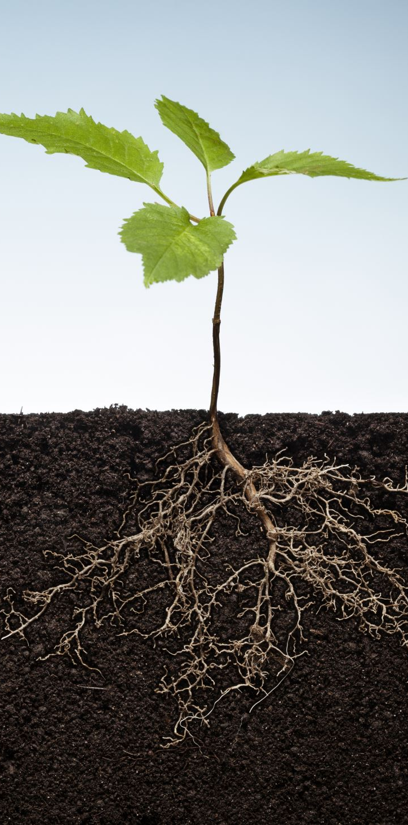
AIM
Same aim, different strategy for different ground
Increase organic matter
  Improve soil quality (dirt to soil)
  Capture carbon
  Absorb and retain water – reduce run-off and erosion
  Improve biodiversity
Notes:
All farms carry stock and are actively involved in regenerative farming practices. The prime objective is to increase organic matter in the soil to improve yield, capture carbon and absorb and retain water.

Slide 4
regenerative agriculture
Strategies for dirt to soil and carbon capture
Stock is key.
Different management practices for different ground (multi-species/trees/grass/etc).
For every 1% we can increase organic matter in our soil we will capture 10 tons of carbon per acre and retain twenty five thousand gallons of water per acre.
This retention of water helps to see us through periods of drought but just as importantly, prevents run off depleting our soil and preventing flash flooding downstream.
Notes:
For every 1% we can increase organic matter in our soil we will capture 10 tons of carbon per acre and retain twenty-five thousand gallons of water per acre.
This retention of water helps to see us through periods of drought but just as importantly, prevents run off depleting our soil and prevents flash flooding downstream.
All the above farms are different requiring different management practices and require stock that is suitable to perform well in each environment but today we are looking at Killochries fold a hill farm running Highland cattle for the pedigree breeding market and finishing steers for high quality, grass finished beef.

Slide 5
We must rectify A failure to learn
Notes:
But first let us consider the problem with farming.
World-wide, it has been the movement away from mixed farms to the development of industrial farming that has caused the most damage.
Industrial farming separates the raising of livestock from their feed source and houses poultry and hogs into confined buildings and cattle in feedlots at densities that make it impossible to safely deal with their effluent.
They then import grain, often from developing countries – grain that could be consumed by humans. 50% of the world’s crop goes to feed livestock.
I believe that this form of farming is one of the main causes of human migration where large areas are ploughed up for monocultures causing desertification and displacing people from the land.
The negative press cattle farmers and ranchers have suffered is beginning to be better understood as not being the problem of the cattle but the way in which they are raised. In Scotland we start from a good position with some of the lowest CO2 outputs in the world from our, grass fed, suckler cattle. However, we have the opportunity to improve from simply being carbon neutral to actually decreasing the legacy load of greenhouse gasses in our atmosphere.

Slide 6
A Failure to learn
It is clear from history that it was only possible to develop cities where the surrounding land was fertile enough to support the city’s population.
As the cities grew the farmers expanded onto the higher ground tilling the soil to grow their crops.
This tillage broke up the natural grasses and allowed rain and wind to deplete the soil, washing the soil into the valley which then choked the organic layer of topsoil forcing the farmers to break new ground as the soils on existing grounds failed to produce.
The Greeks then the Romans ruined their soils forcing them to seek new lands where they could grow grain to feed their cities.
In more recent times we ploughed up the American prairies resulting in the “Dust Bowl” which bankrupted the farmers.

Slide 7
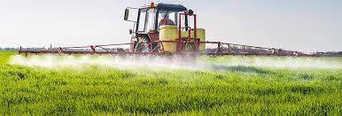
Today, with modern machinery, we are able to till ground at a rate way beyond anything possible in the past.
If industrial agriculture continues at the current level, we may have only sixty harvest left before we deplete the world’s remaining topsoil.
If Industrial agriculture is a major cause of soil erosion & CO2 release, Regenerative agriculture is a key solution

Slide 8
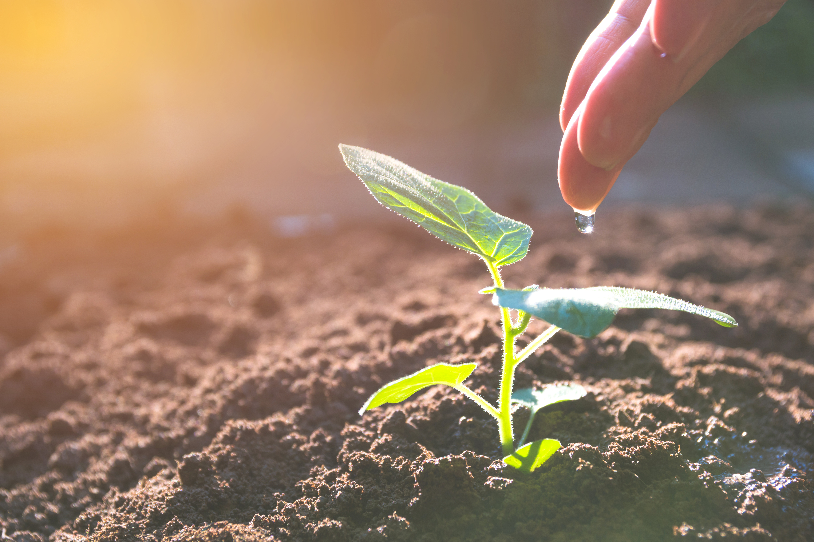
How to create topsoil
Rocks erode then plants establish themselves, their roots then speed up the process of rock erosion allowing more plants and trees to establish themselves. This process takes millions of years yet today we are loosing soil at a rate between ten and one hundred times faster than nature can make it.
The grasslands of the world, the great plains of America, the Savannahs of Africa were created by great herds of herbivores bunching tightly together for safety and constantly being moved on by predators, like lions and wolves, perhaps not returning to the same spot for a year.
These huge groups, packed tightly together, opened the ground with their feet, allowing new grasses to germinate and fed the topsoil with their dung and urine.
This is how nature made grasslands and it is the method we must mimic if we are to protect and develop our topsoil’s.
If we work with nature, rather than against nature, we can restore and build our soils and at the same time capture carbon.

Slide 9
5 principles of regenerative agriculture
By Gabe Brown ‘Dirt to Soil’
They are the same any place in the world where the sun shines and plants grow. The principles are:
limit disturbance of the soil
keep soil covered with plants at all times
strive for diversity
maintain a living root system because it feeds the soil biology
integrate animals – nature does not function without animals.”

Slide 10
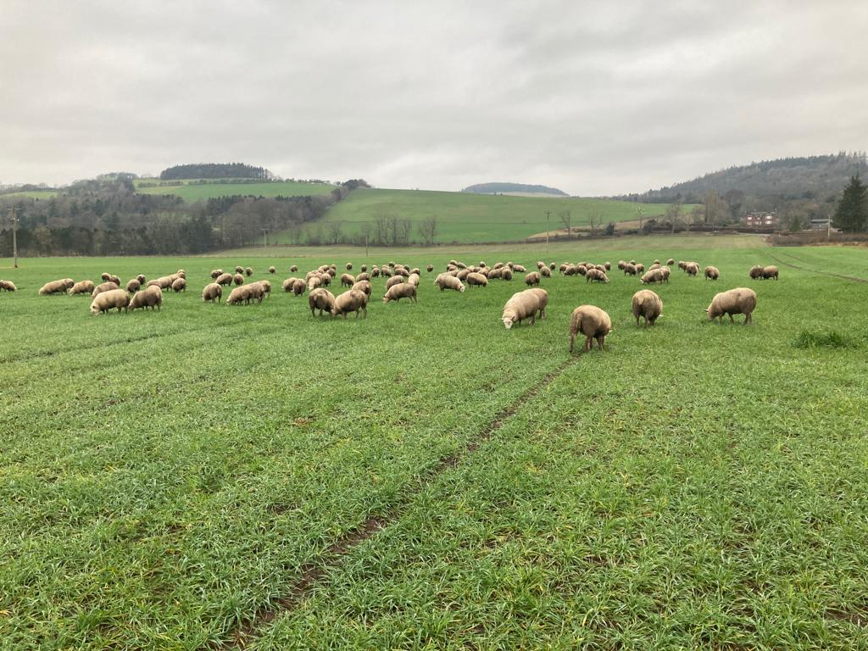
Principle One.
Limit the Disturbance.
The first principle is to limit mechanical, chemical and physical disturbance of the soil.
A move towards “no till” will dramatically reduce the fuel required and prevent the carbon release caused by ploughing.
Sheep grazing winter barley seeded using direct drill at Balgay Farm.

Slide 11
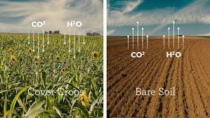
Principle Two.
Armour the soil surface.
The second principle is to maintain armour (of plant residues) on the soil surface.
Ploughing in the autumn leaves the land bare to break down. Tilling and seeding in the spring causes soil loss through runoff and starves the fungi and soil bacteria. This removes the underground food supply starving all soil life including earthworms.
What farmer would starve his livestock all winter, why then, during the winter, would you starve your underground livestock.
Bare soil releases carbon whereas covered soil captures it. This is the biggest carbon capture tool at our disposal.

Slide 12
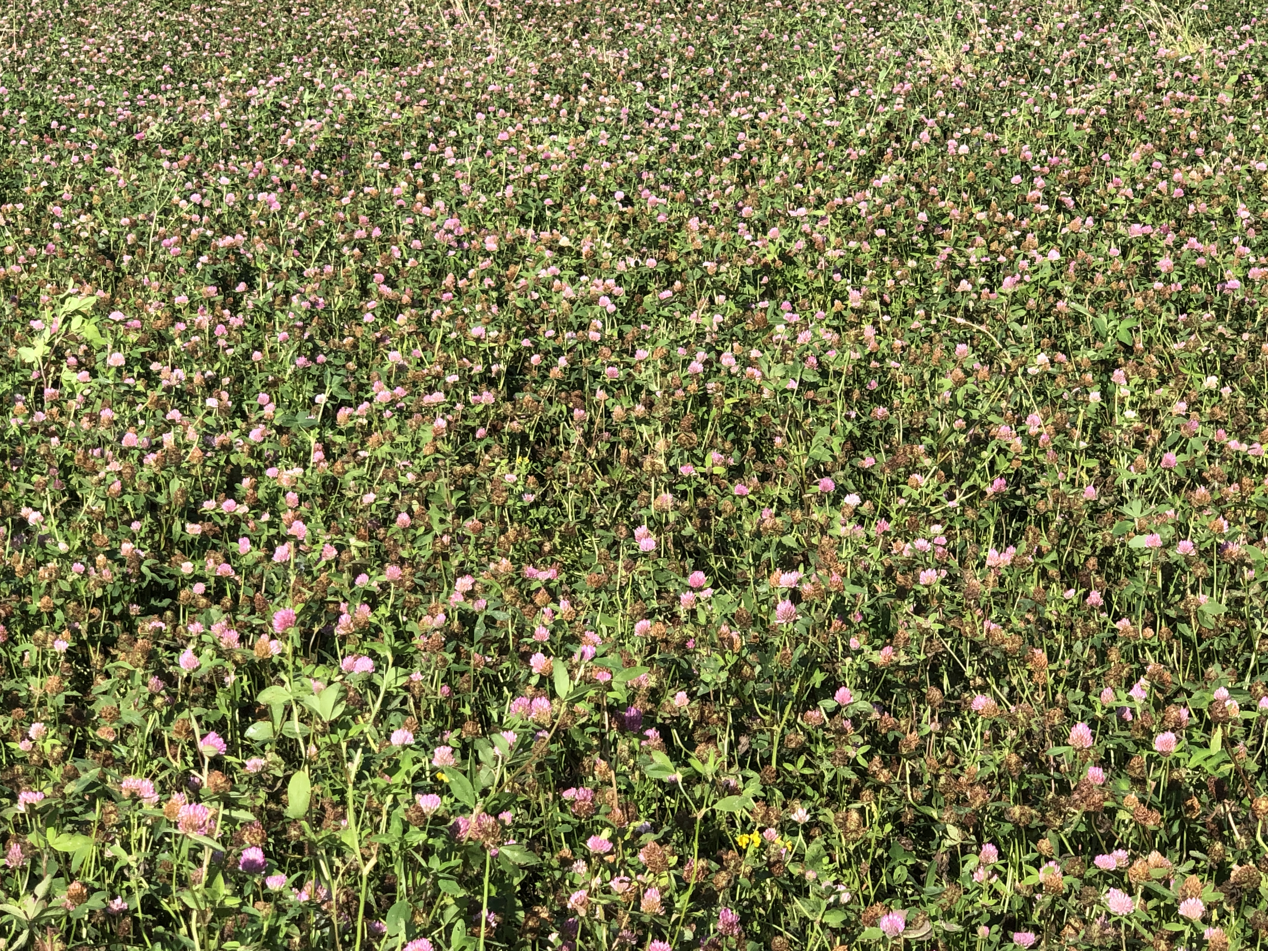
Principle Three.
Build diversity.
The more plant diversity in the soil the greater the potential to build organic matter and capture carbon.
Legumes, like clovers, set nitrogen, reducing the requirement for chemical fertilisers.
Chicory, plantain and red clovers are all deep rooted and with grasses the soil now feeds on root exudates of many plants. Think of the amount of carbon cycled due to all these living plants.
Multi-species herbal lay at Killochries Fold, Lukestone Farm

Slide 13
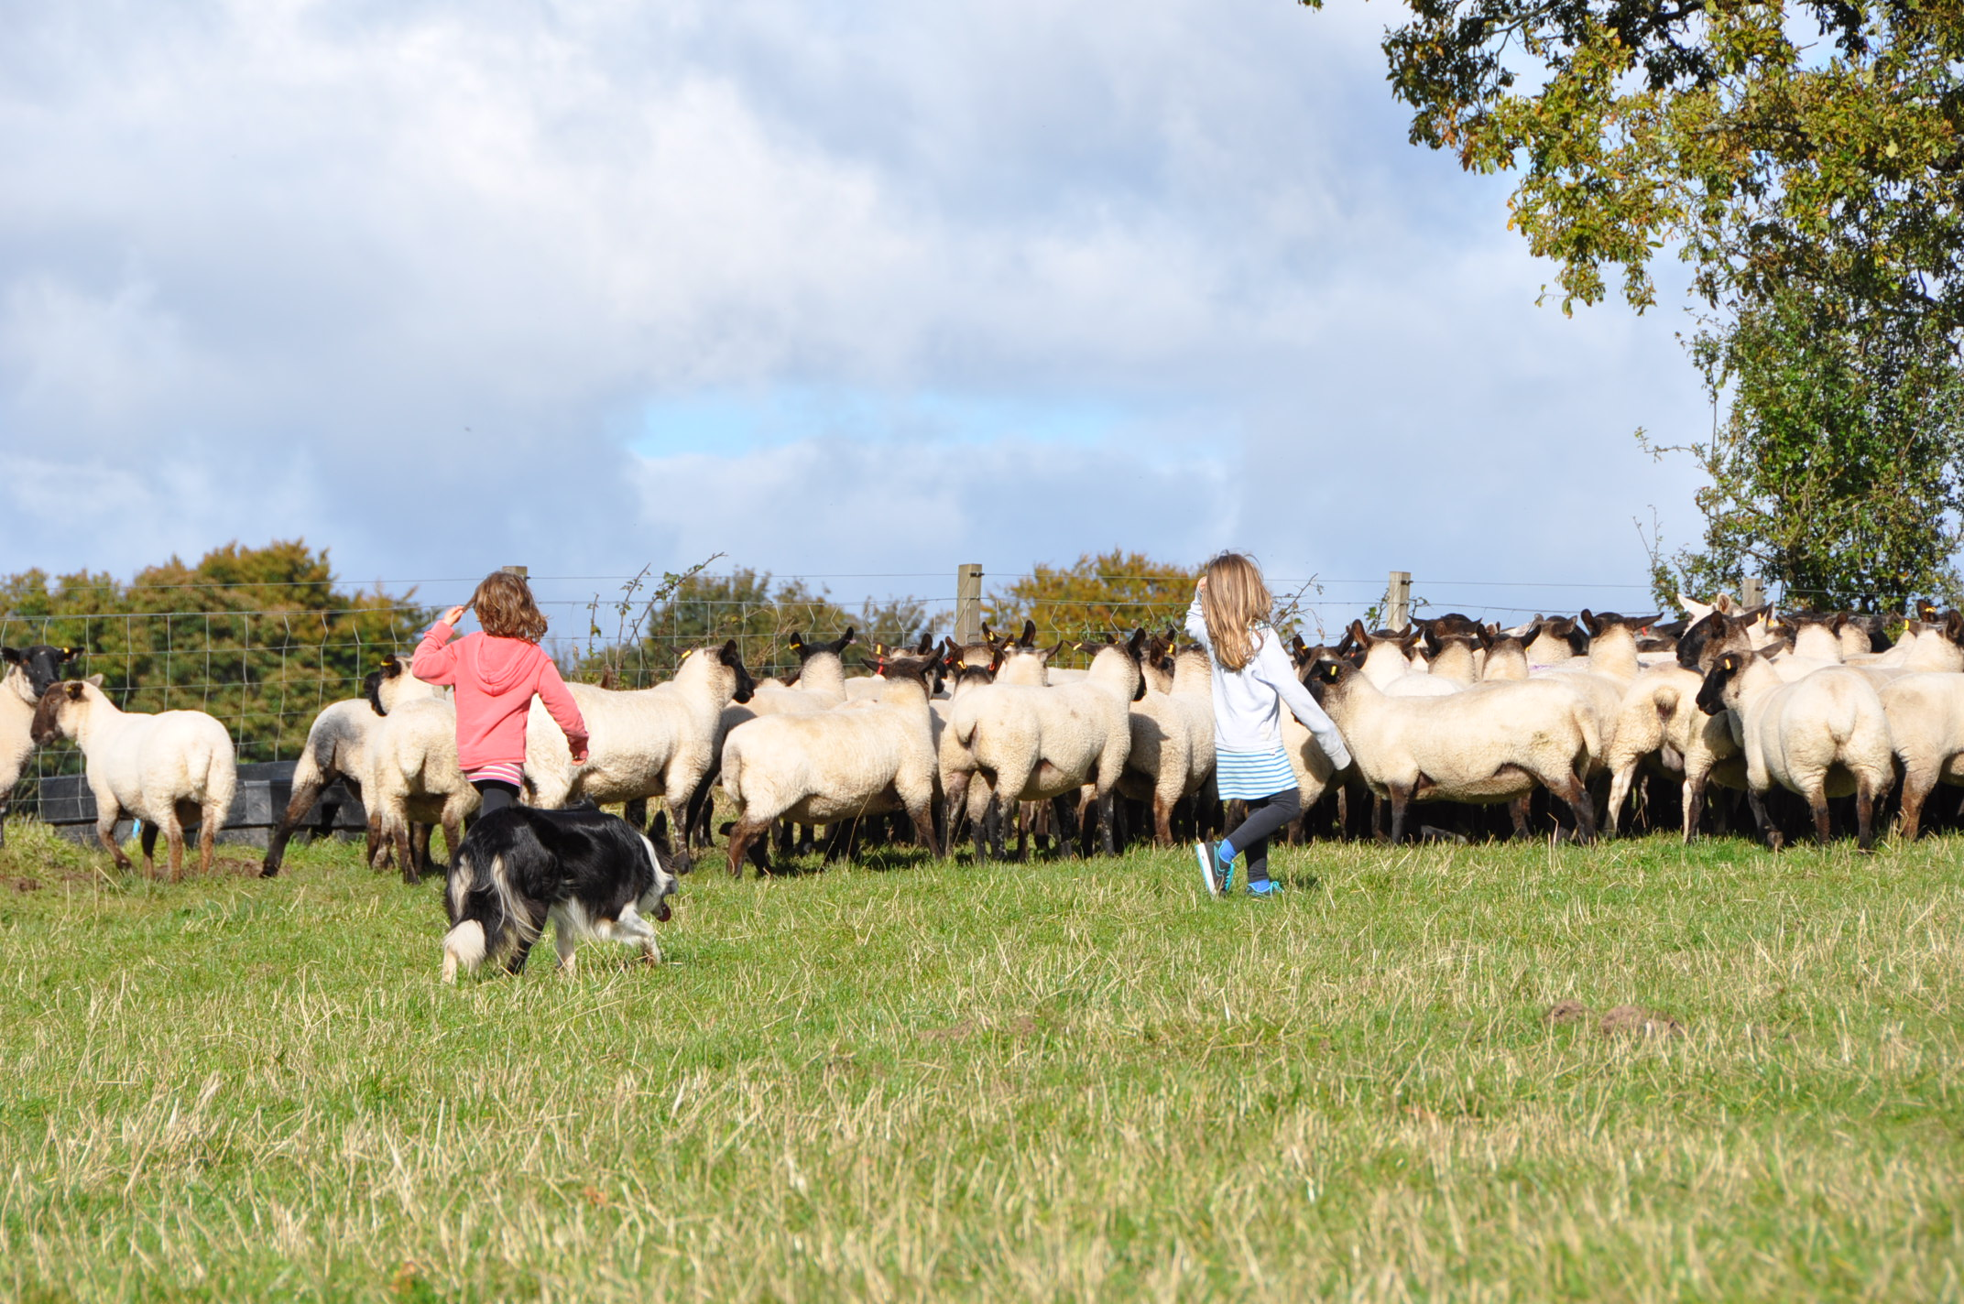
Principle Four.
Keep living roots in the soil.
The fourth principle is to maintain living roots in the soil as long as possible throughout the year.
Leaving the ground bare throughout the winter starves the “underground livestock” and promotes erosion and runoff.

Slide 14
Principle Five.
Integrate animals.
What difference does it make?
The answer is that this is the way the tens of millions of bison, elk, deer and other ruminants created the great grasslands of the world.
Worldwide, it has been the movement away from mixed farms to the development of industrial farming that has caused the most damage.

Slide 15
Industrialised farming is the problem.
Water pollution.
Separates the raising of livestock from their feed source and houses poultry and hogs into confined buildings and cattle in feedlots at densities that make it impossible to safely deal with their effluent.
Mis-use of land.
They then import grain, often from developing countries – grain that could be consumed by humans. 50% of the world’s crop goes to feed livestock.
Displacing people from land and causing poverty.
I believe that this form of farming is one of the main causes of human migration where large areas are ploughed up for monocultures causing desertification and displacing people from the land.
Regenerative farming is the solution.
Notes:
The negative press cattle farmers and ranchers have suffered is beginning to be better understood as not being the problem of the cattle but the way in which they are raised.
In Scotland we start from a good position with some of the lowest CO2 outputs in the world from our, grass fed, suckler cattle.
However, we have the opportunity to improve - from simply being carbon neutral - to actually decreasing the legacy load of greenhouse gasses in our atmosphere.

Slide 16
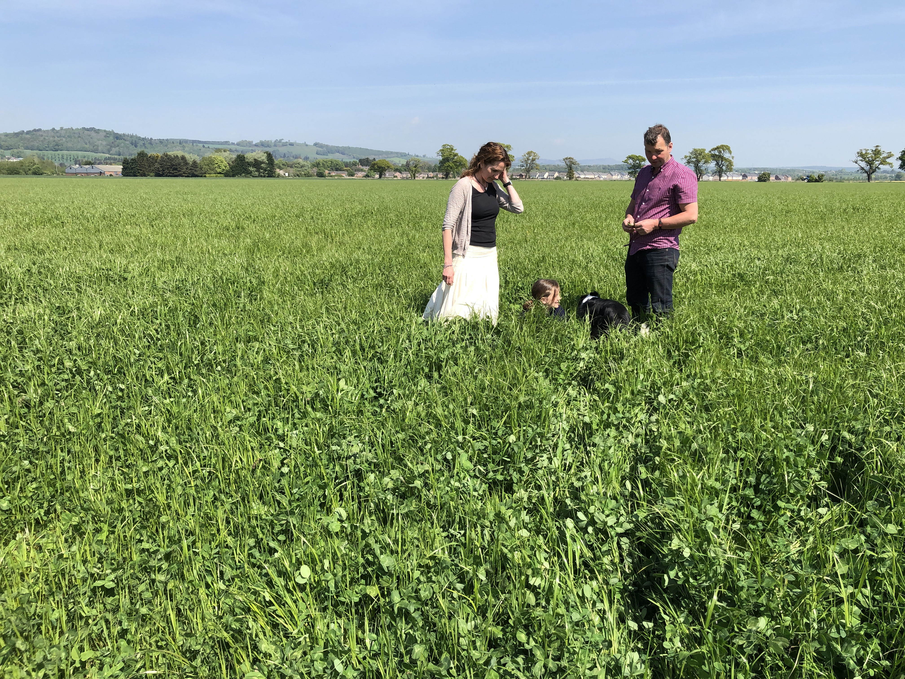
Multi species herbal lay at Balgay Farm.
Notes:
At Balgay we inherited a farm where the soil had been constantly tilled for crop. The soil behaved like heavy clay with little organic matter. Red clover and rye grass was introduced as a silage crop and remained in the ground for three years before going back to crop.
Tillage was used to establish the wheat crop after grass and for the first-time birds were seen to be following the plough to feast on the turned over ground. Tillage was easier requiring less power and therefore less fuel from the tractor.
Shorthorn and Angus grazing cattle were introduced on newly drained and established grassland.
Today we have moved to zero till for most of the farm.
Trash is left on the ground to armour the soil and in theory, we can establish the new crop by zero till straight after the combine.

Slide 17
Sheep grazing winter barley, seeded using direct drill at Balgay Farm.
Notes:
A single pass of the zero till gives a fuel saving of 30 litres per hectare and a saving of over 800 hours if the whole farm was zero tilled.
By being able to put the new crop in early we are not so exposed to the short window between harvest and new crop establishment.
By going early with the new crop we get good establishment before the winter sets in. This early growth can be damaged by the winter weather so it is grazed of with sheep prior to the arrival of the bad weather.
By grazing the crop with sheep we stimulate root growth and cause the plant to tiller. The dung from the sheep fertilizes the plant and feeds the soil bacteria and fungi.
So far we have seen small increases in yield where the crops have been grazed by sheep and little on no loss in yield from zero till.
Cattle grazing multi species grassland and dunging on the ground and the spreading of dung from winter housing have all had a dramatic positive effect on the soil structure, increasing the organic content by putting liquid carbon back in the ground.

Slide 18
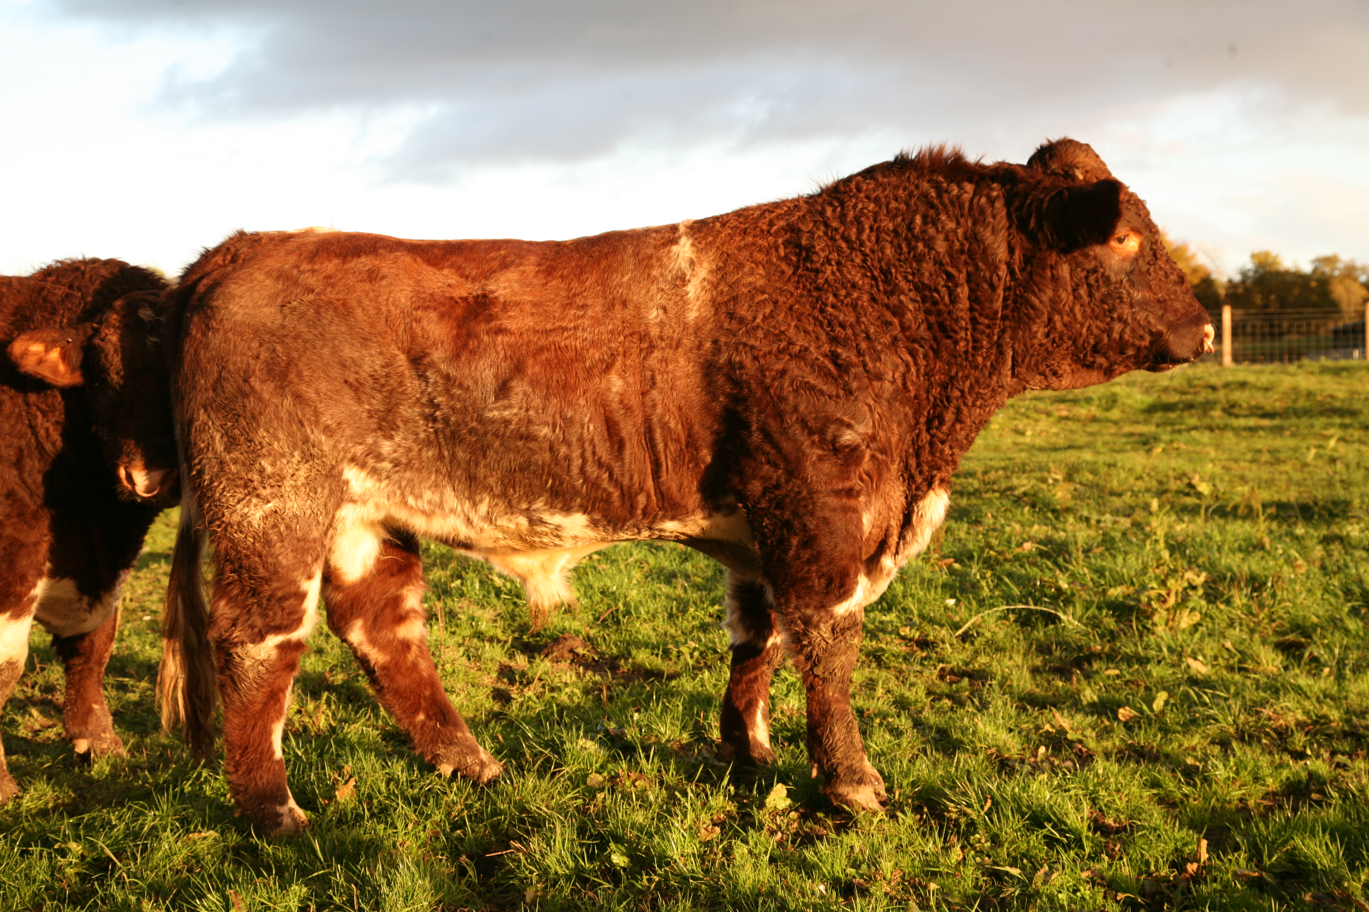
ORGANIC MATTER AND CARBON CAPTURE
Drumcross Farm, Bishopton
At purchase in 2008, Organic matter was less than 3%. Now, being in permanent grass, grazed by the cattle, the soil tests this year revealed the average across the farm is in excess of 9%.
This equates to an improvement of 6% X 180 acres X 10 tons of carbon @ 1% = 10,800 tons of carbon captured on this small farm.
Killochries Fold and Lukeston Farm
Cattle and sheep have always been run here. Today organic matter is in the high teens, with some fields over 20%.
Notes:
Drumcross Farm in Bishopton was purchased in 2008. Drumcross extends to about 180 acres and previously was let out as a crop farm.
When we purchased Drumcross we put it into grass to run pedigree Beef Shorthorns.
Decision makers must understand these facts so that they understand that; well-managed and grazed properly, livestock are the solution not the problem.
Here our livestock eat grass and drink water from natural sources. They are clearly carbon negative and create a food source that supports and improves biodiversity.

Slide 19
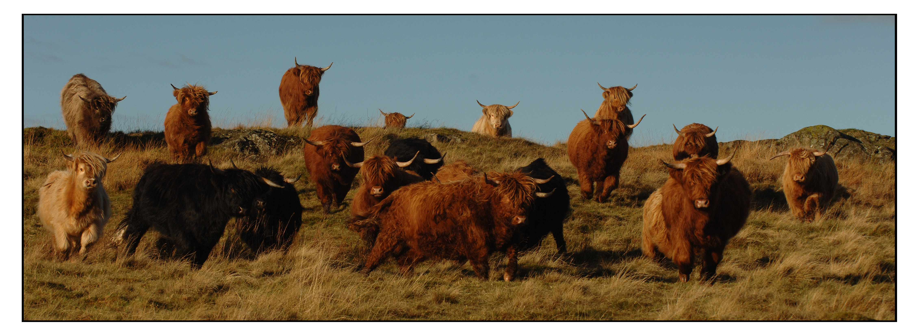
BIODIVERSITY
Each Killochries hill cow produces 25% of her bodyweight in invertebrate life each season.
The average weight of our Highlanders is over 500Kg, so each season every cow produces 125Kg of invertebrate life - feeding soil life, mammals and birds, right up to the birds of prey.
Notes:
This winter we propose to out winter our Highlanders on the moor to demonstrate their ability to improve biodiversity and to bring back and increase life on the moor.
Highlanders, Galloway’s and their crosses are perhaps the only breeds capable of surviving and thriving in the moor’s winter conditions.
Cattle graze swards differently to sheep, goats and horses. They use their tongue to tear vegetation and this, together with their size, gives some important benefits in natural vegetation systems.
Some of the benefits of using cattle in a natural vegetation system include.
They are less selective grazers than sheep or goats.
Highlanders have the ability to remove low digestibility biomass.
Trampling helps to open up dense swards creating conditions for germination and regeneration. This creates opportunities for species such as heather.
Cattle can help to control invasive grasses such as mat grass and purple moor-grass.
They use distinct grazing and lying areas leading to an uneven distribution of grazing over the sward, increasing biodiversity by creating a greater variation in the sward structure.
They break the woody material, which maintains the plant in an early stage of growth.

Slide 20
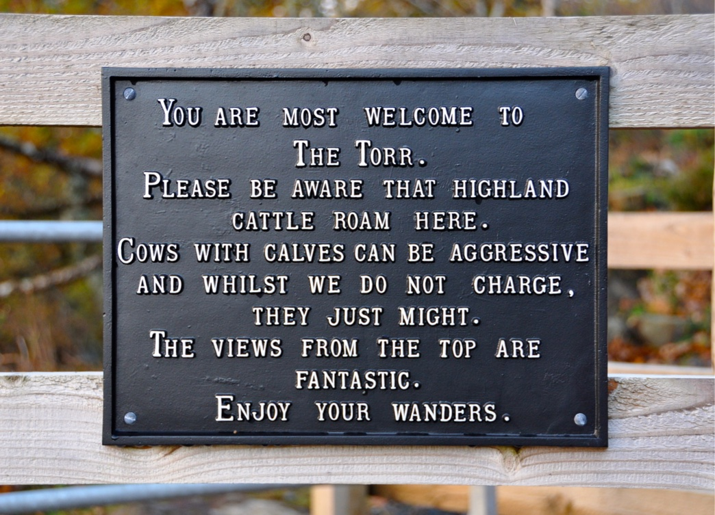
DIRT TO SOIL & BIODIVERSITY
The main advantage of out wintering on moorland is their ability to digest poor quality forage that has oxidised and is chocking regrowth. Purple moor-grass is a good example of an invasive grass Highlanders will remove during winter grazing.
During feeding, the cattle will tramp out the area, increasing soil organic matter and leaving small areas of soil exposed allowing germination of heather seed.
The same feeding area should not be reused during the same season to allow rest and regeneration.
Notes:
Provided a low impact vehicle is available each cow can be supplemented with 2.5Kg per day, of beet pulp or cattle cobs.
The cobs should be fed on a different area each day, choosing an area of old rank heather or Molinia grass.
The cattle should be removed late February early March before the nesting season of the ground nesting birds.
At no time should feeding stations for hay or silage be used.

Slide 21
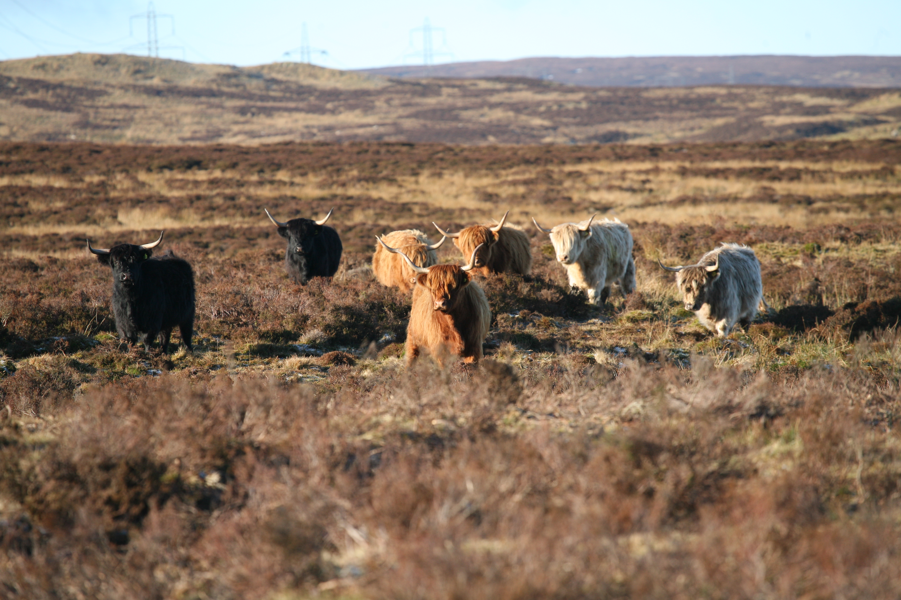
WHAT ARE THE ADVANTAGES?
Plant biodiversity will improve resulting in better water penetration, which will, in turn, improve runoff and water quality.
Cattle dung provides winter feed for microbes, fungi, soil bacteria and worms providing continuous, all the year round, food for the life cycle right up to the birds of prey.
Spring grasses will be greener with greater diversity providing a better habitat for both sheep and birds.
Risk of wildfire will be reduced by the removal of oxidized grasses.
Requirement for muir burning is reduced as cattle will lie on rank heather to gain a “dry bed” crushing the plants to allow younger heather to prosper.
Notes:
Provided a low impact vehicle is available each cow can be supplemented with 2.5Kg per day, of beet pulp or cattle cobs.
The cobs should be fed on a different area each day, choosing an area of old rank heather or Molinia grass.
The cattle should be removed late February early March before the nesting season of the ground nesting birds.
At no time should feeding stations for hay or silage be used.

Slide 23
Some resources I have found helpful
Thank you for joining us at Lukeston!

